Slide 1
Zepto sales Data Data Analysis(SQL Projects)
By MO YASIR

Slide 2
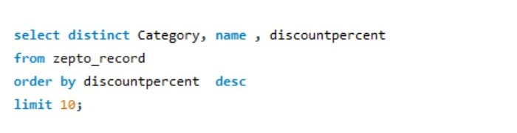
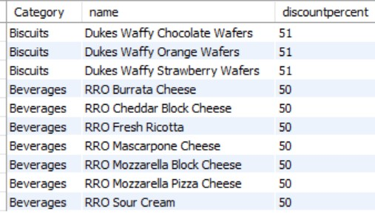
1. Find the top 10 best value product based on the discount percentage.

Slide 3
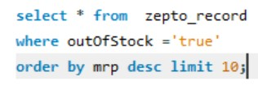
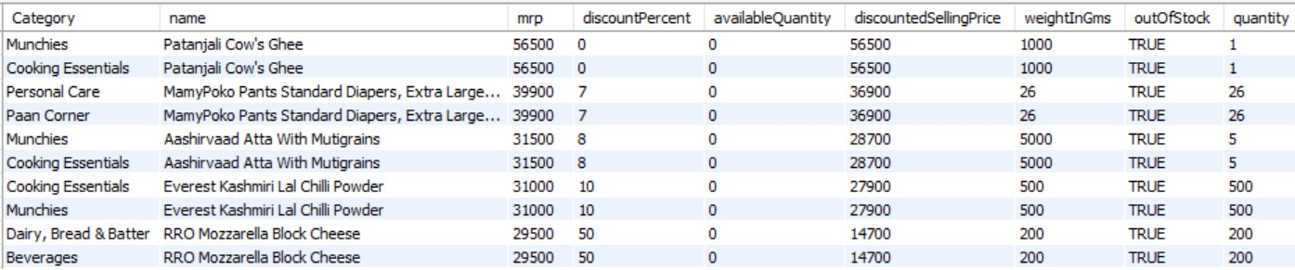
Q.2 Wha are the products with high MRP BUT out os stock

Slide 4
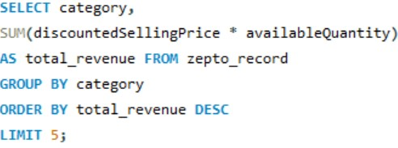
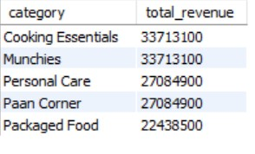
Q.3 calculate estimate revenue for each category

Slide 5
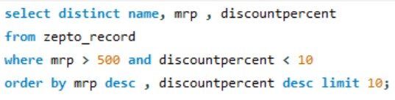
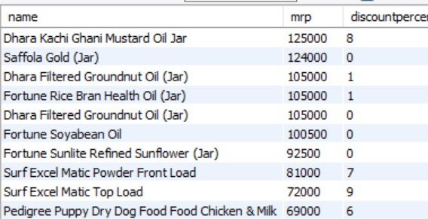
Q.4 Find all product where is MRP is greater than 500 rupees and dicount is less than 10%.

Slide 6
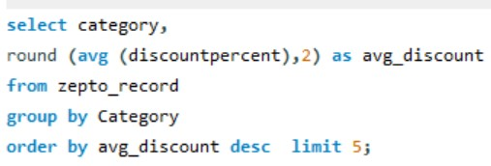
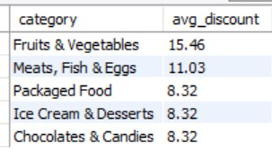
Q.5 Identify the top categories offering the highest average discount percentage.

Slide 7
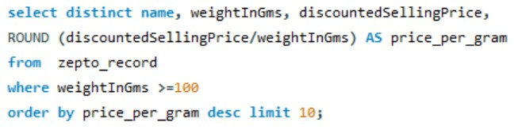
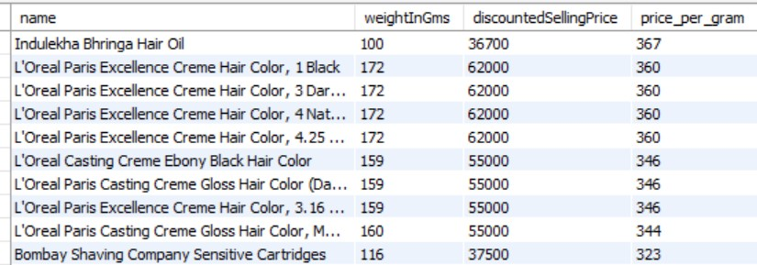
Q.6 Find the price per gram for product above 100g and short best value.

Slide 8
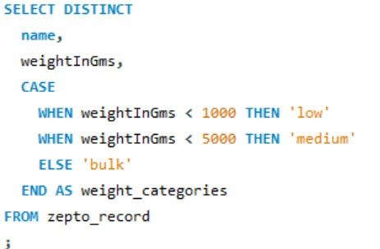
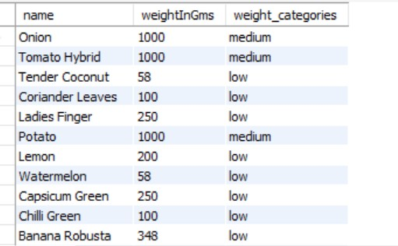
Q.7 group the product onto ctegories like low , medium , bulk.

Slide 9
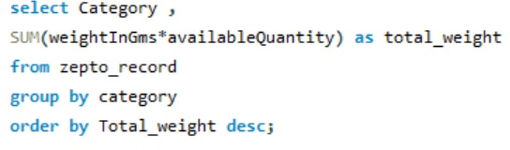
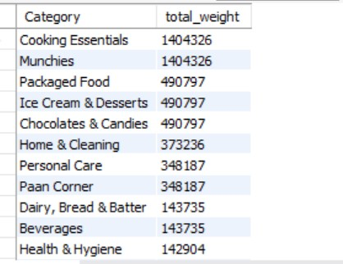
Q.8 What is total Inventory Weight per category.

